Slide 1
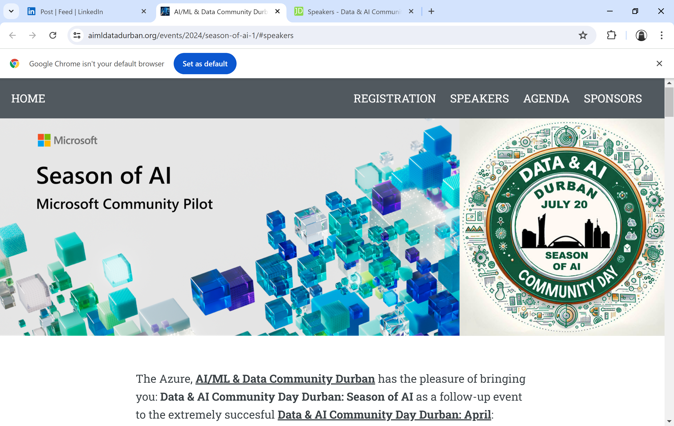
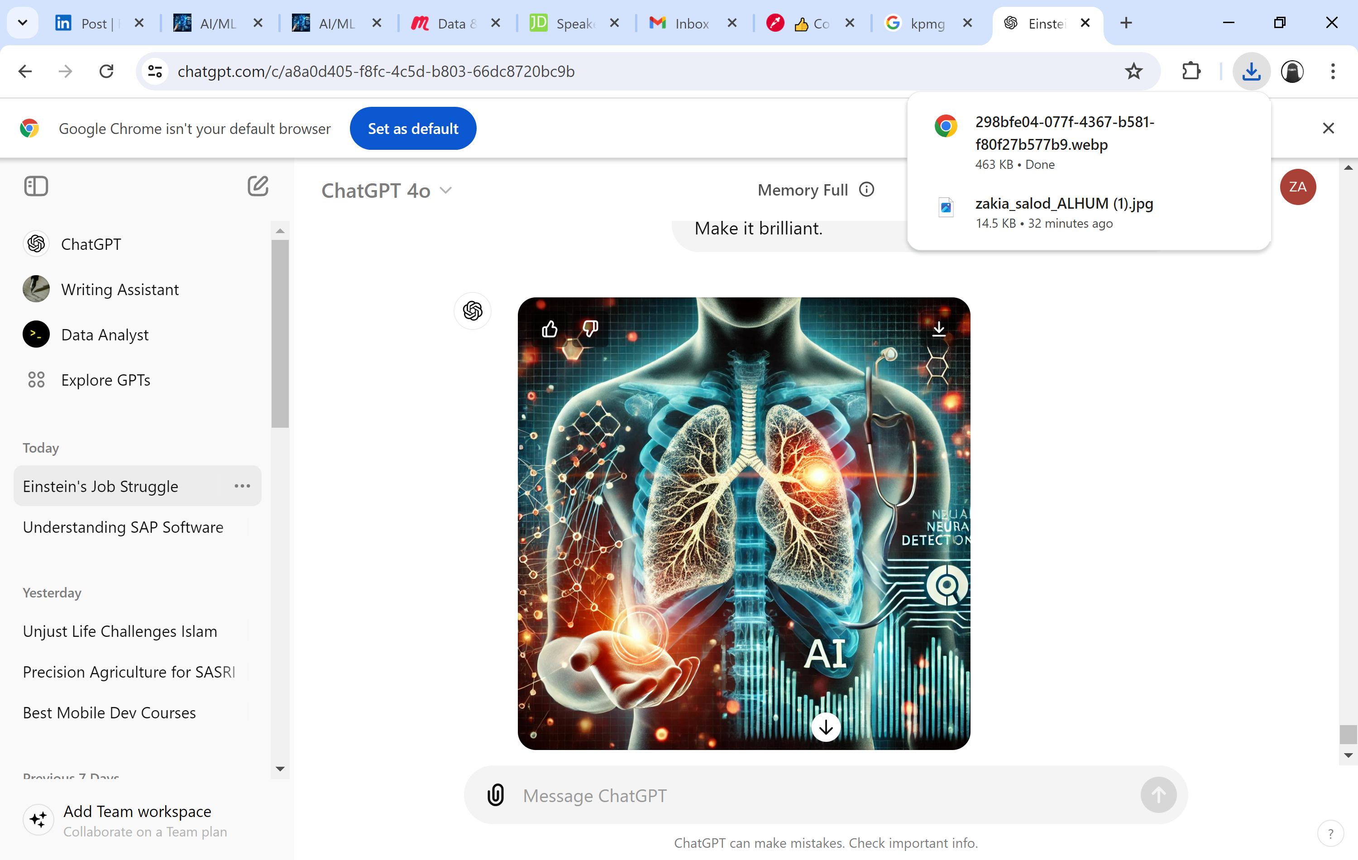




Building and Deploying a Pneumonia Detection Model with Fast.ai and Gradio
Dr Zakia Salod
Data & AI Community Day Durban: Season of AI
Coastlands Umhlanga Hotel & Convention Centre, Umhlanga, Durban, South Africa
20 July 2024

Slide 2
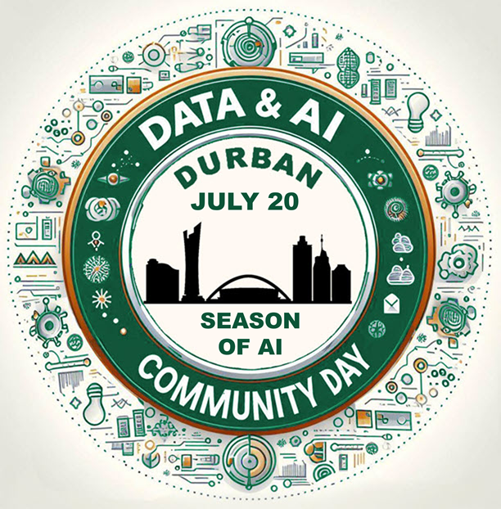








THANK YOU TO OUR SPONSORS

Slide 3

About Me – Dr Zakia Salod
PhD Public Health
MMedSc Medical Informatics
BCom Honours Information Systems and Technology
BSc Computer Science and Information Technology
Primary School, High School, to Matric
medical artificial intelligence
computer science
information technology
medical informatics
public health
research
philanthropy
art
3

Slide 4
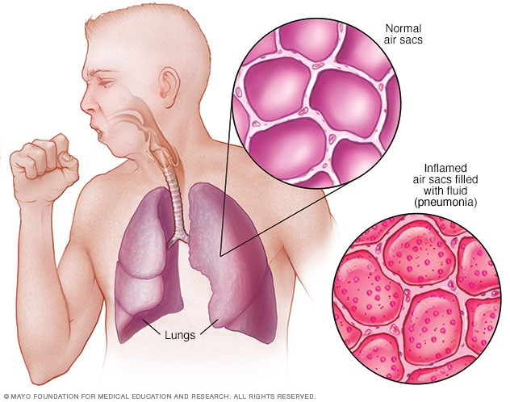
What is Pneumonia?
Pneumonia is an infection that causes inflammation in the air sacs of one or both lungs.
These air sacs may become filled with fluid or pus, leading to symptoms such as cough with phlegm, fever, chills, and difficulty breathing.
Various organisms, including bacteria, viruses, and fungi, can cause pneumonia.
The severity of pneumonia can range from mild to severe, and it can be life-threatening.
The most vulnerable groups include infants, young children, the elderly (65+), and individuals with underlying health conditions or weakened immune systems.
[Source: https://www.mayoclinic.org/diseases-conditions/pneumonia/symptoms-causes/syc-20354204]
4

Slide 5
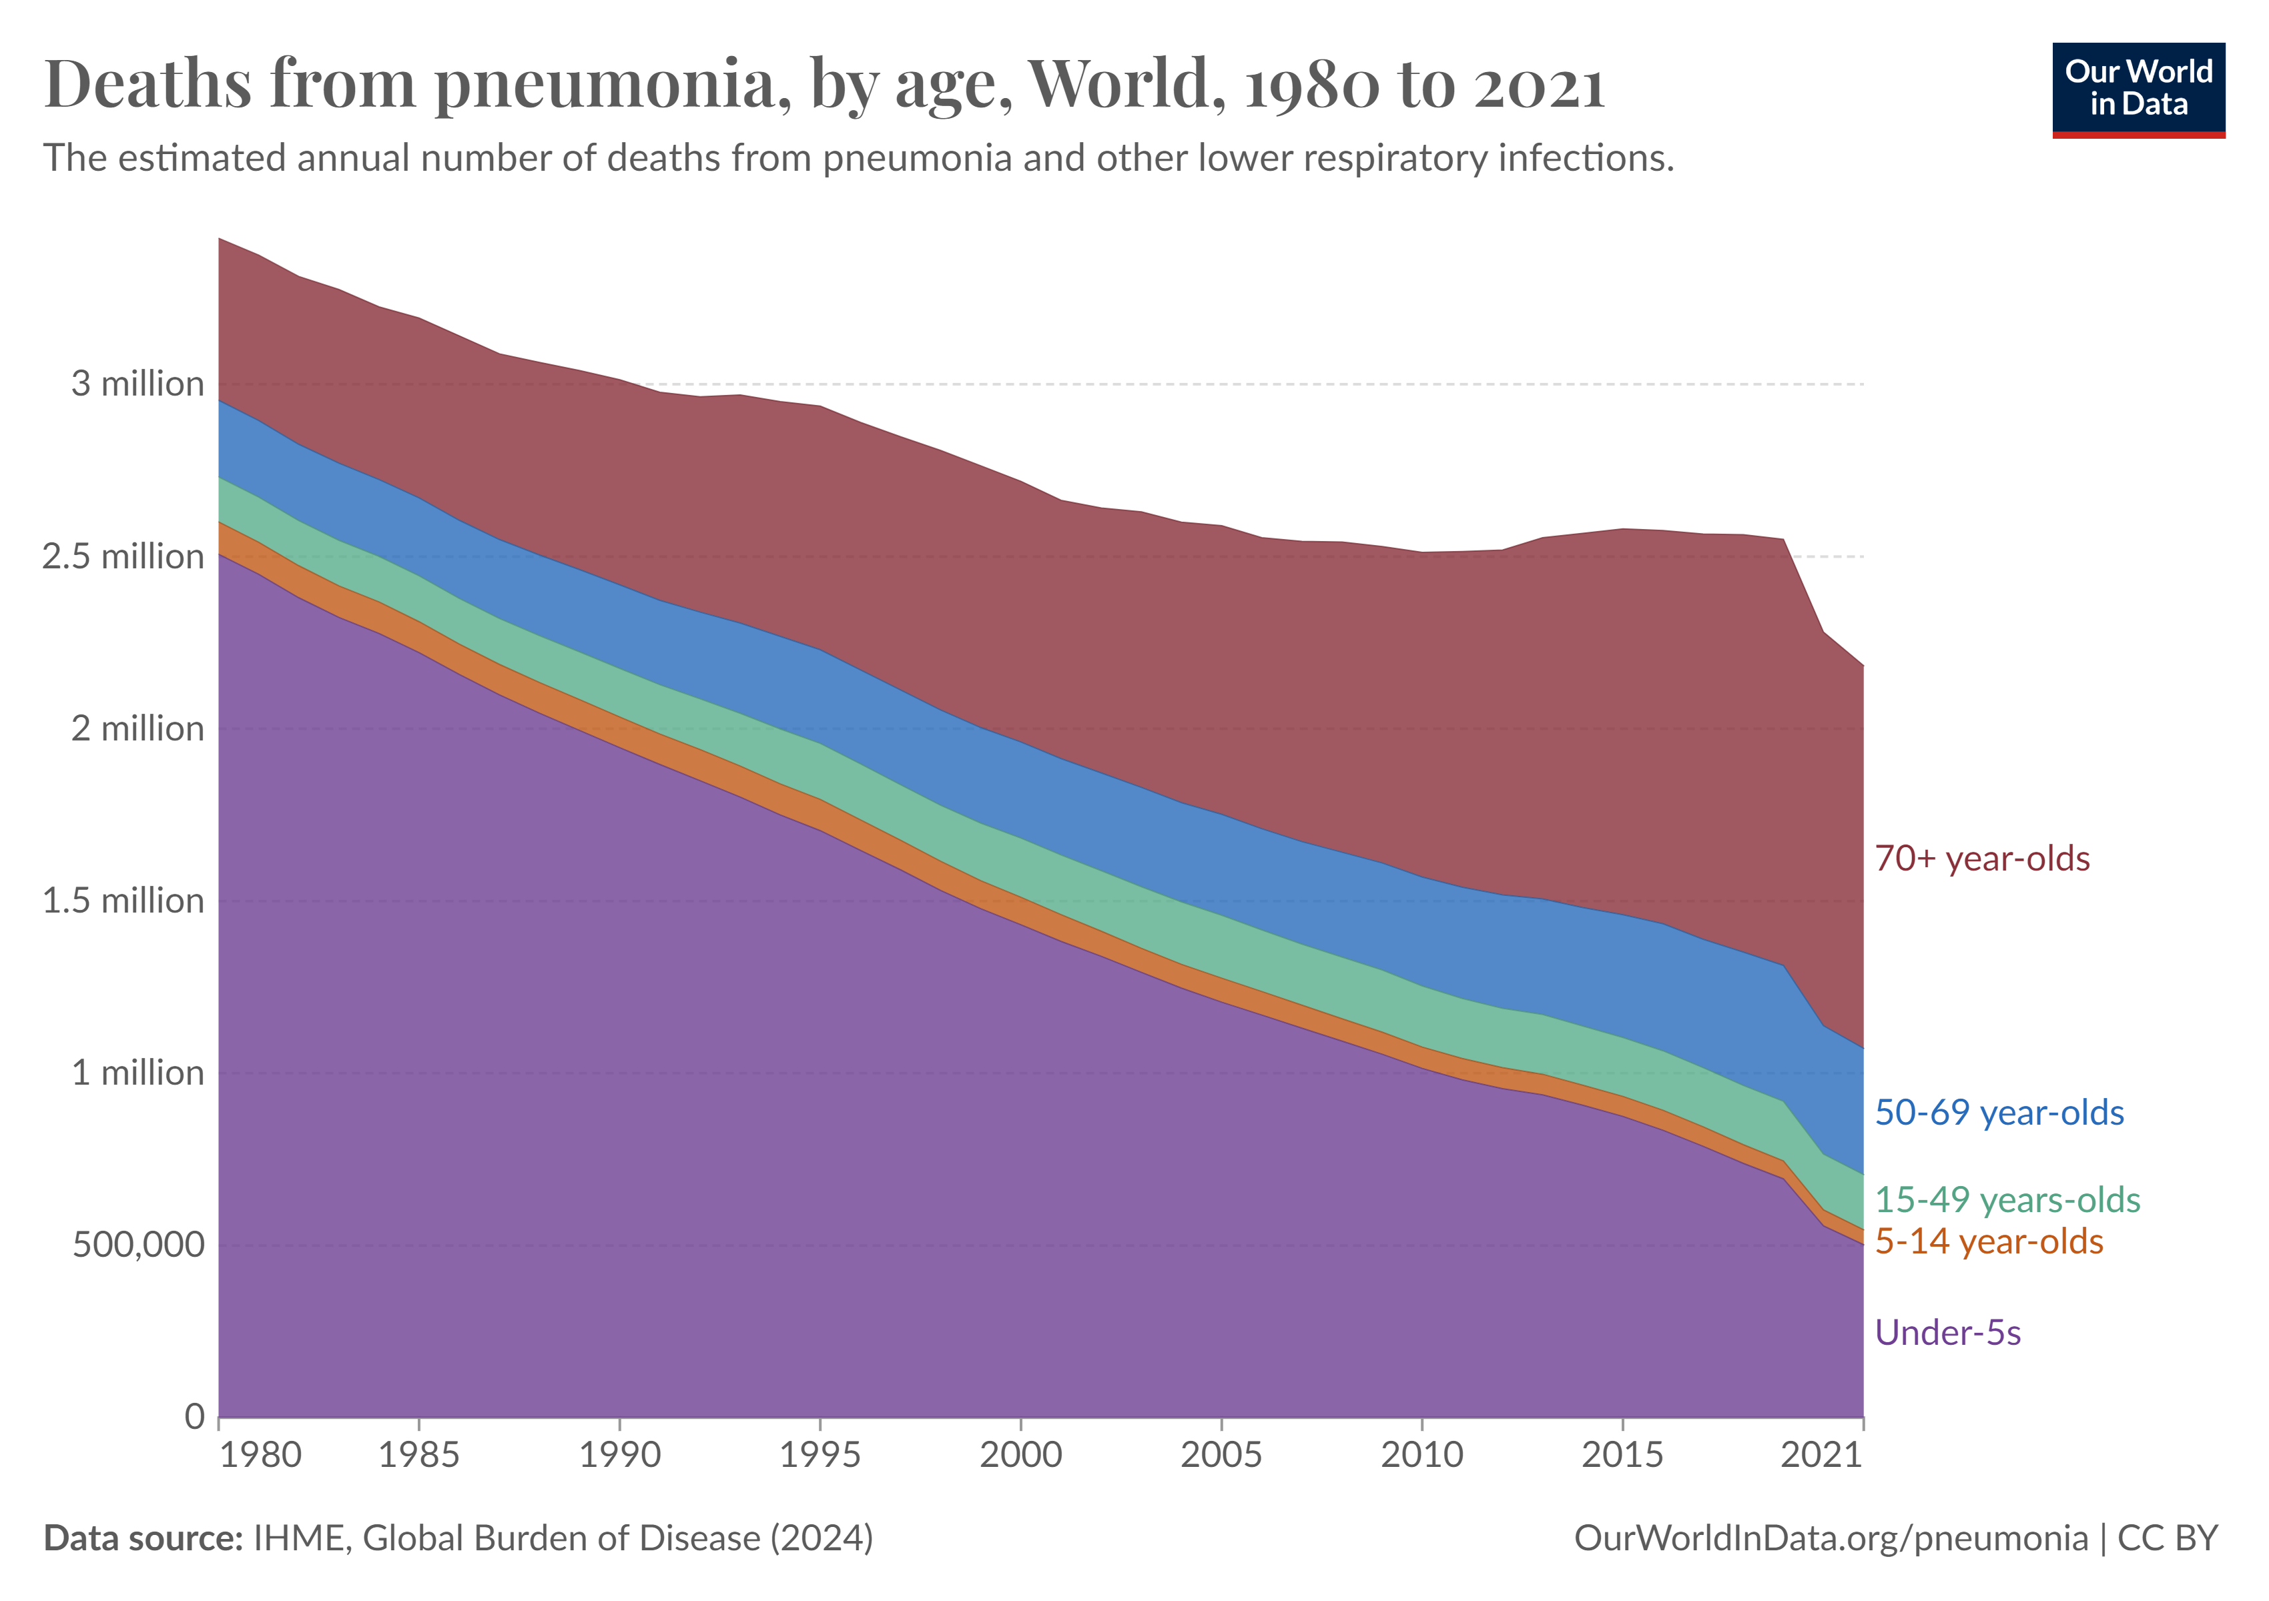
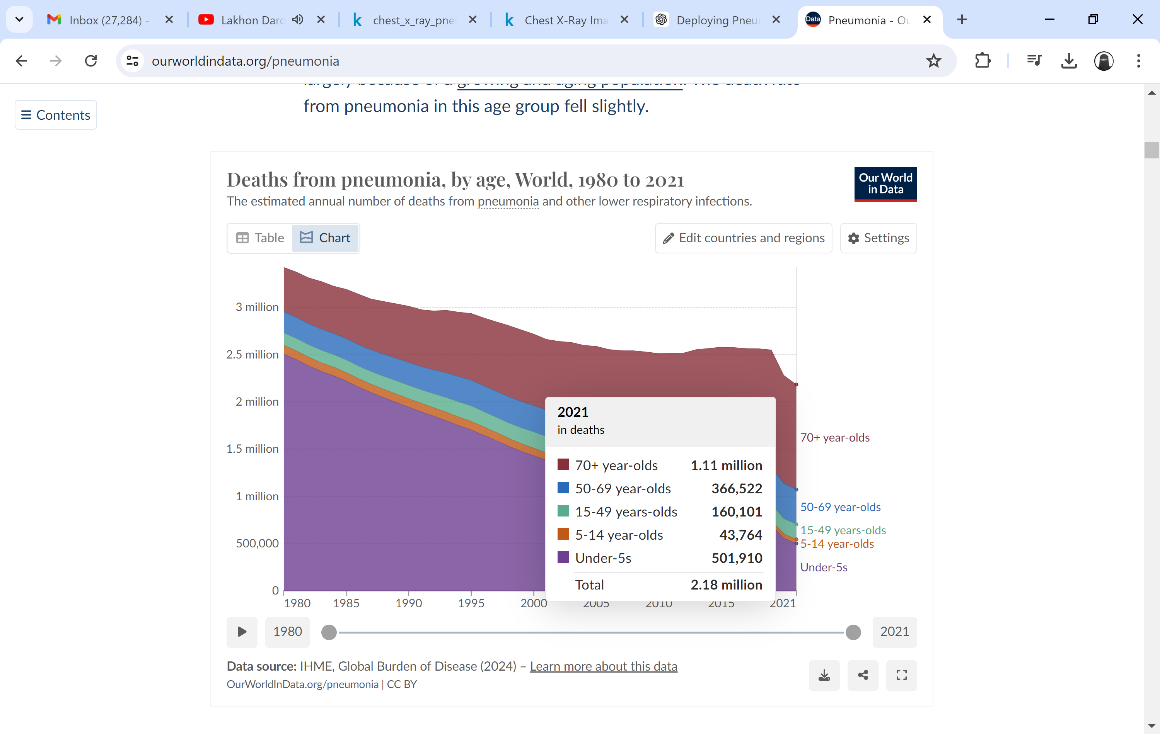
Global Pneumonia Mortality
by Age in 2021
[Source: https://ourworldindata.org/pneumonia]
5

Slide 6
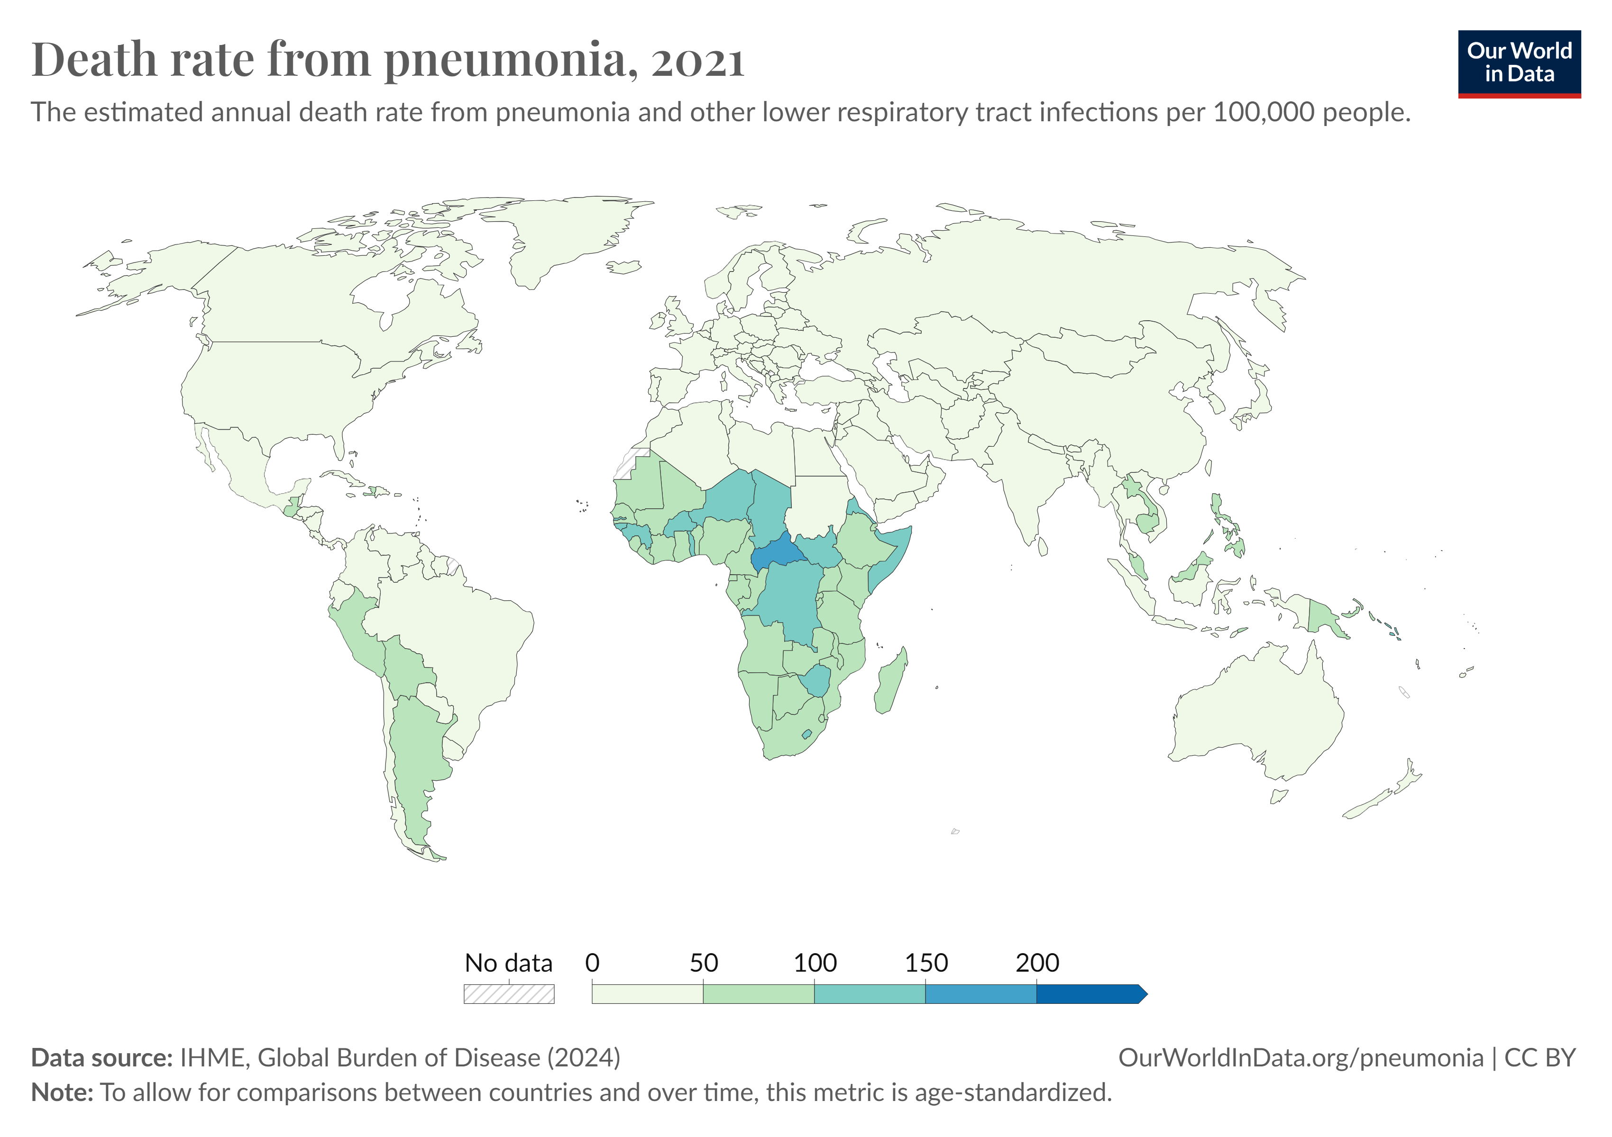
Global Pneumonia Mortality Rate
by Country in 2021
World:
28.7 per 100,000 people
Africa:
80.4 per 100,000 people
South Africa:
65.3 per 100,000 people
[Source: https://ourworldindata.org/pneumonia]
6

Slide 7




What is Artificial Intelligence (AI)?
A computer science field
focused on developing intelligent machines
Can perform tasks that usually require human intelligence
Has been around since the 1950s
Is currently growing: ↑data creation + ↑computing power
Definition
History
Current
7

Slide 8
AI Tools
Machine Learning:
“Field of study that gives computers the ability to learn without being explicitly programmed.”
- Arthur Samuel (1959)
Artificial Intelligence
Machine Learning
Deep Learning
Data Science:
“Science of extracting knowledge and insights from data.”
- Andrew Ng, DeepLearning.AI
Deep Learning:
“Deep learning is a subfield of machine learning concerned with algorithms inspired by the structure and function of the brain called artificial neural networks.”
- Ian Goodfellow, Yoshua Bengio, & Aaron Courville (2016)
Data Science
8

Slide 9

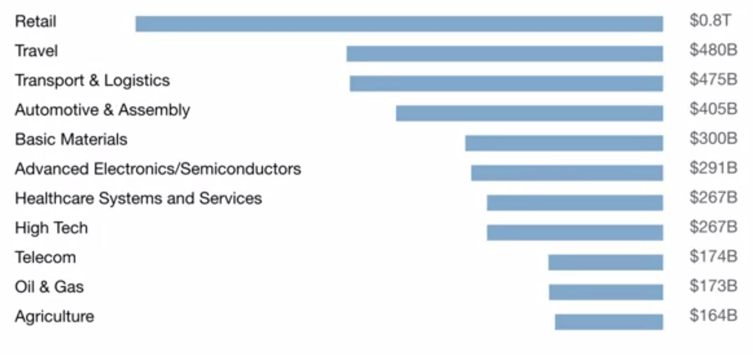



AI All Around Us
Examples of AI in Everyday Life
Projected AI Value Creation
by 2030
$13
trillion
Examples of AI in Different Domains
[Source: McKinsey Global Institute]
9

Slide 10
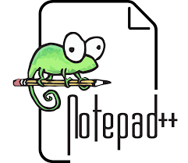
AI for Pneumonia Detection:
A Four (4) Step Process
Kaggle: Build (train) the model using fast.ai and the chest-xray-pneumonia dataset (train and val). Then, export the PKL file (pneumonia_model.pkl).
Step 2
Hugging Face: Create a Hugging Face space for the app (pneumonia-detection-with-fast.ai-and-gradio).
Step 3
Notepad++: Write the user interface code (app.py) with Gradio and create the requirements.txt file.
Step 4
Upload Files via Hugging Face Spaces: Upload the following files to your Hugging Face space: (1) User interface code (app.py); (2) requirements.txt file; (3) Example x-ray images from the test set; and (4) PKL file (pneumonia_model.pkl)
Step 1
10

Slide 11

Quick Quiz Time
Get Ready to Test What You’ve Learned!
Scan the QR Code or Enter the PIN on Kahoot.it
QR Code & PIN will be Displayed On-Screen Shortly
11

Slide 12
References
The Dataset
2
Fast.ai: https://www.fast.ai/
3
Gradio: https://www.gradio.app/
4
Hugging Face: https://huggingface.co/
1
Kaggle: https://www.kaggle.com/datasets/paultimothymooney/chest-xray-pneumonia
Journal Article: https://www.cell.com/cell/fulltext/S0092-8674(18)30154-5
Book: https://github.com/fastai/fastbook
Amazon: https://www.amazon.com/Deep-Learning-Coders-fastai-PyTorch/dp/1492045527
The app from this presentation: https://huggingface.co/spaces/Zakia/pneumonia-detection-with-fast.ai-and-gradio
12

Slide 13
GitHub Repository
https://github.com/ZakiaSalod/pneumonia-detection-with-fast.ai-and-gradio
13

Slide 14
Thank You Any Questions?
Dr Zakia Salod
Data & AI Community Day Durban: Season of AI
Coastlands Umhlanga Hotel & Convention Centre, Umhlanga, Durban, South Africa
20 July 2024

Slide 15
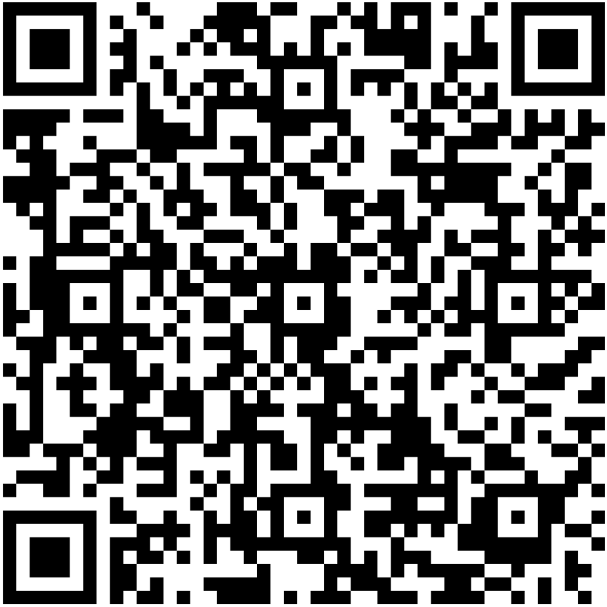
DON'T FORGET SESSION EVALUATION
Please evaluate the session!
Enter your name on the evaluation form to stand a chance to win awesome prizes!
URL: https://forms.office.com/r/WWx2vCJW0y

